Slide 1
Retrieval and storage
Andrew Zheng, Joseph Hong, Vrundal Shah, Rifaa Qadri, Xinchen Yang

Slide 2
Introduction
In the realm of Natural Language Processing (NLP), tasks such as question answering, text summarizing, fact checking, machine translation, rely heavily on practical and efficient retrieval mechanisms to retrieve relevant documents pertaining to a user's query.
Traditional techniques such as BM25 used by GAIA provide functionality to retrieve documents from large textual datasets based on user queries, but is limited to near-exact matches and suffer from lexical gap and therefore do not generalize well.
We aim to create a scalable, efficient and user friendly zero-shot setup retrieval system, able to retrieve relevant documents for a given query without having been trained on any data pertaining to it.
Additionally, we aim to work towards building a user friendly interface which popular engines such as GAIA lack.

Slide 3
State of the Art
GAIA - User-friendly interface that collect multiple datasets into one
First “user-friendly” interface
Citation: Aleksandra Piktus, Odunayo Ogundepo, Christopher Akiki, Akintunde Oladipo, Xinyu Zhang, Hailey Schoelkopf, Stella Biderman, Martin Potthast, and Jimmy Lin. 2023. Gaia search: Hugging face and pyserini interoperability for nlp training data exploration.
Unsupervised Dense information retrieval with contrastive learning.
State of the art embedding
Citation: Gautier Izacard, Mathilde Caron, Lucas Hosseini, Sebastian Riedel, Piotr Bojanowski, Armand Joulin, and Edouard Grave. 2022. Unsupervised dense information retrieval with contrastive learning.

Slide 4
Project Goals(Vrundal)

Slide 5
Methods
Approach
We will implement a user-friendly interface for document query and retrieval
We will compare several query-document embedding and retrieval techniques for searching
Programming Language: Everything will be coded in Python
Github: Code will be hosted on a github repository
Datastax: Will be used to store our indices.

Slide 6

DataStax
Document → vector → Datasta

Slide 7
Approach & Timeline
9/22-10/13: Setup methodology and pipeline for testing different vector embedding methods
10/14 - 10/20: analyze different methods
10/21 - 10/28: determine which method to use
10/ 29 - 11/4: Set up AWS account and Grab common crawl, and/or c4, . . .
11/11 - 11/19: Stash the resulting data into a datastax database
11/19 - 11/29: MVP for frontend integrated with the backend
11/30- end of semester: Buffer for deployment issues or unforeseen circumstances
Addition of memorization into queries will be done if time permits

Slide 8
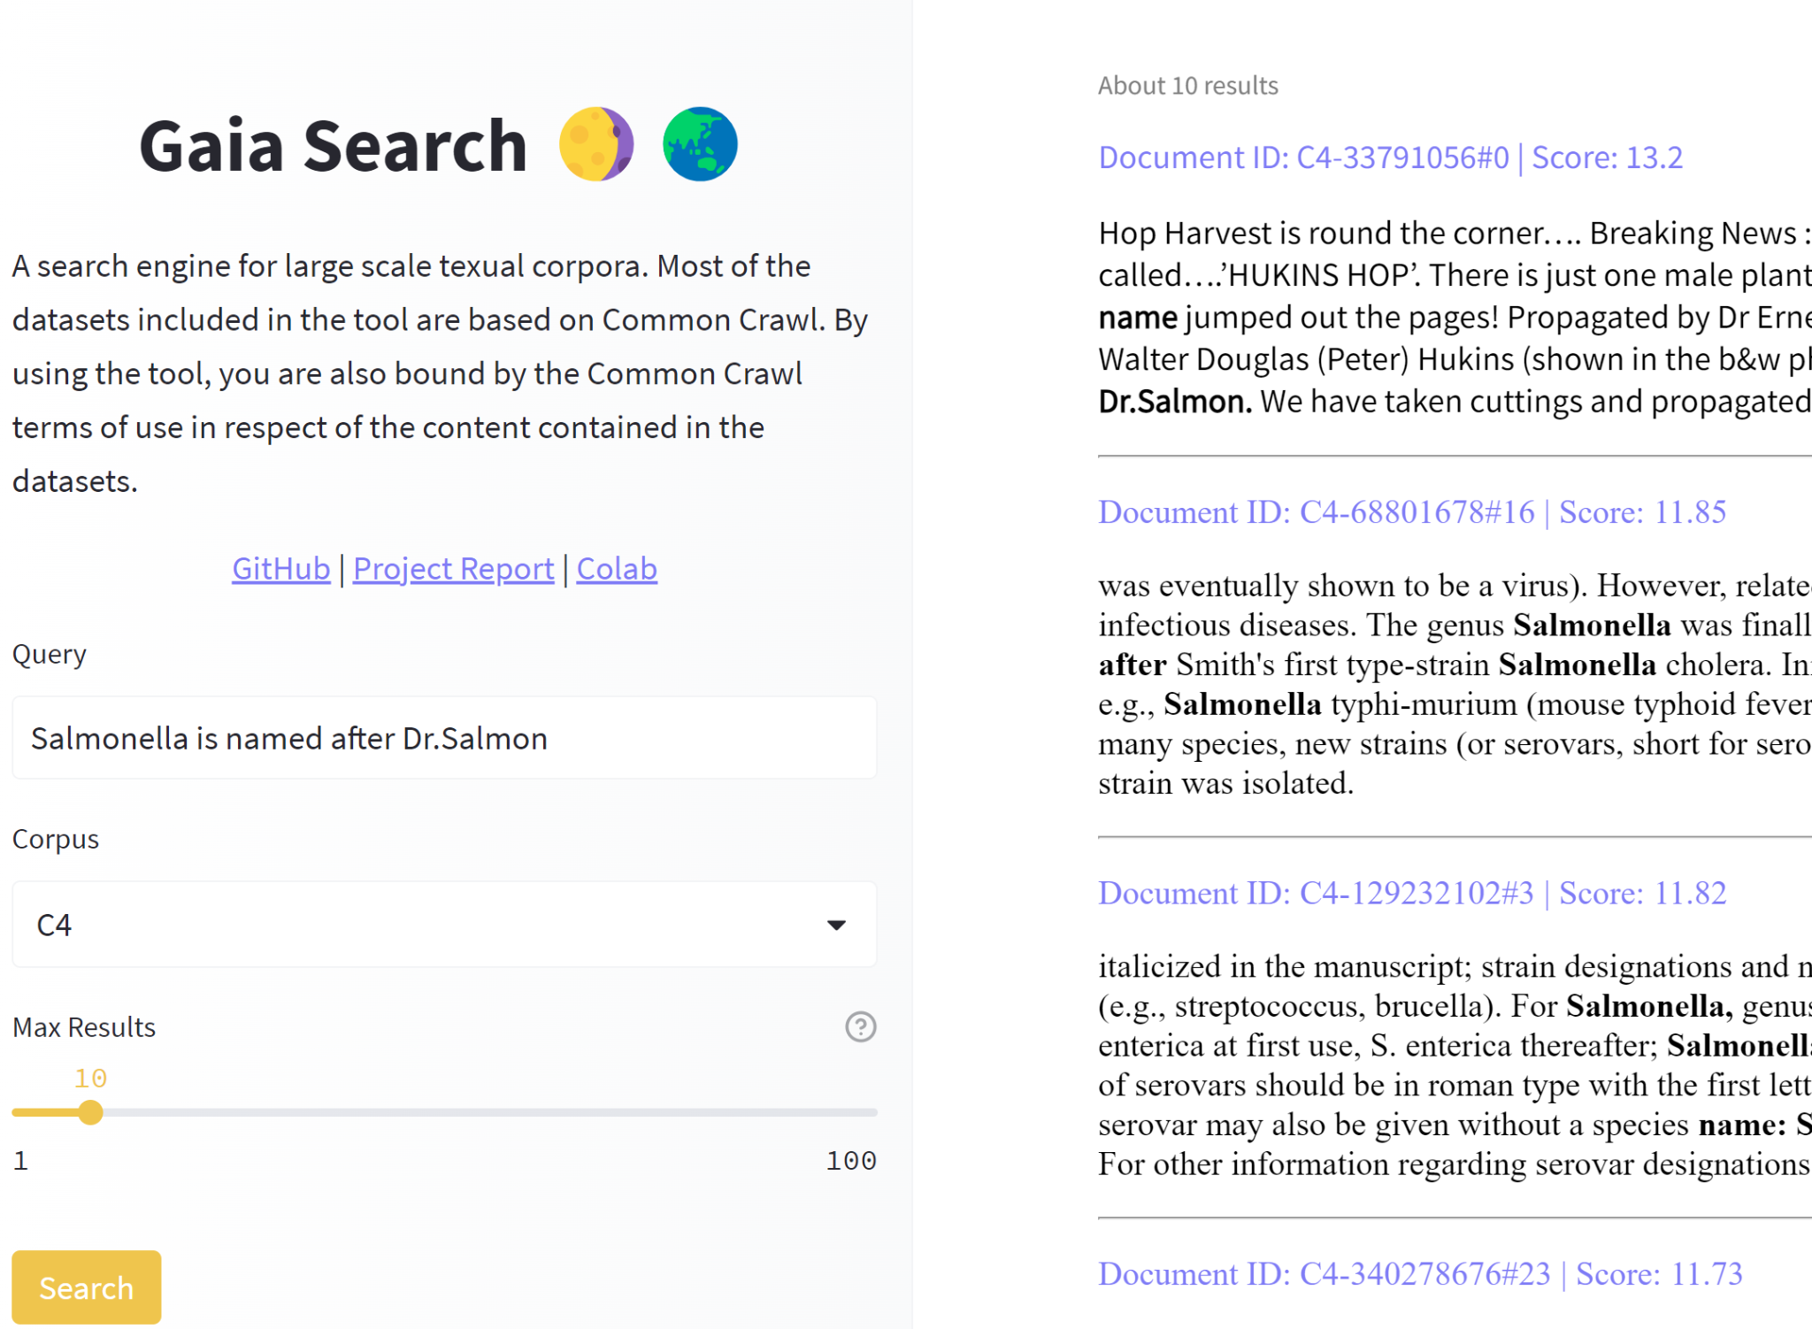
Deliverable
Improved version of GAIA Search
User inputs a query, it outputs a list of documents most similar
If possible, will give the actual link and dataset of where the document is from

Slide 9
Github Repository
Link: github.com/rifaaQ/cmsc674

